Slide 1
Data Structures & Algorithms (CSC-214)
Lec 1: Motivation

Slide 2
Motivational Example
A cellular service company provides contract to its 10 million users
Due to new security enforcements, the company wants to prevent issuing of multiple contracts to users
Method of Detecting Multiple Contracts
Before issuing a new contract to a user
First search the id of the user in the existing contracts database
In case of a failure -> issue a new contract to the user
In case of a success -> do not issue a new contract to the user

Slide 3
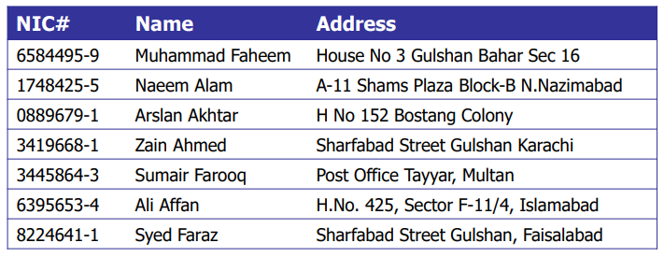
Example: Linear Array Data Structure (1)
Linear Array (with 10 million entries)
Three arrays (NIC, Name, Address)

Slide 4
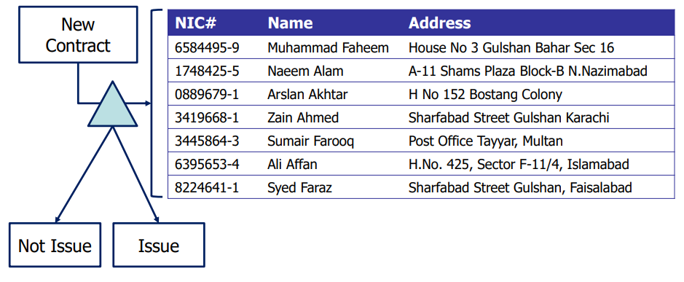
Example: Linear Array Data Structure (2)
Any disadvantage of the linear array data structure?
How to improve?

Slide 5
Example: Improved Data Structure
Create a dictionary data structure
Group similar records together
Similarity in terms of first digit of NIC number
Add a dictionary entry for each distinct digit (0 – 9)
Example: 3419668-1, 3445864-3, 1748425-5
3 and 1 are dictionary entries
Existing contracts are searched in two steps
1. Search the dictionary entry (i.e., group searching)
2. Search contract within the group (i.e., with the same NIC digit)
How much improvement w.r.t. linear array?

Slide 6
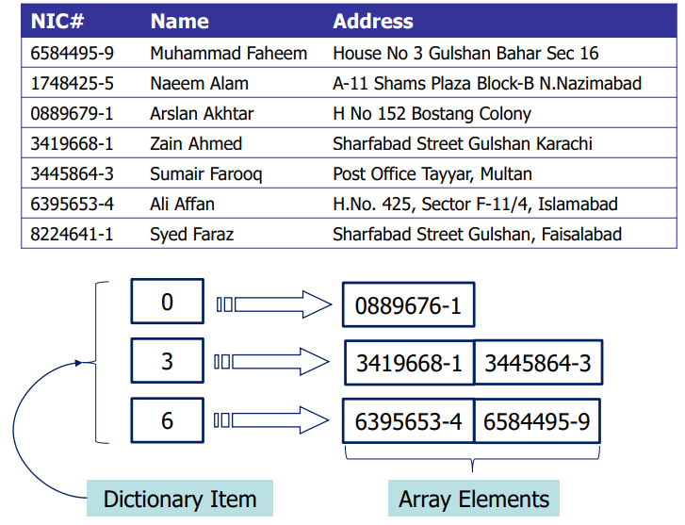
Example: Dictionary Data Structure (1)

Slide 7
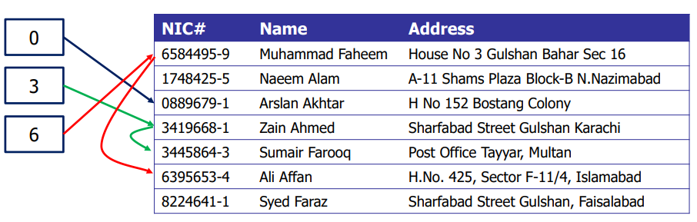
Example: Dictionary Data Structure (2)
Another possibility
Maintain pointers with structures (or records)
Non-NULL pointer indicates presence of next record

Slide 8
Issues in Data Structures
Array based?
Pointer based?
Dictionary based?

Slide 9
Issues in Data Structures
Array based?
Slow search, high memory usage, insertion and deletion issues
Simpler data structure
Pointer based?
Memory usage
Easier insertion and deletion
Dictionary based?
Requires more memory, uneven distribution of data within groups
Faster lookup

Slide 10
Any Questions?

